Slide 1

Introduction to Data Mining Chapter 3 Classification – Basic Concepts
by Michael Hahsler
Based in Slides by Tan, Steinbach, Karpatne, Kumar

Slide 2


R Code Examples
Available R Code examples are indicated on slides by the R logo
The Examples are available at https://mhahsler.github.io/Introduction_to_Data_Mining_R_Examples/

Slide 3
Topics
Introduction
Decision Trees
Overview
Tree Induction
Overfitting and other Practical Issues
Model Selection and Evaluation
Metrics for Performance Evaluation
Methods to Obtain Reliable Estimates
Model Comparison (Relative Performance)
Feature Selection

Slide 4
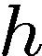
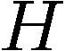
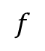
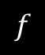
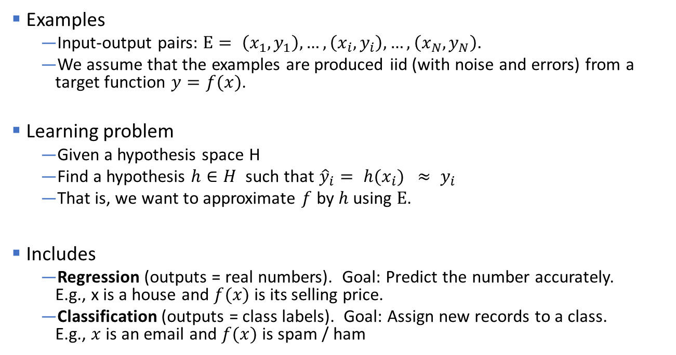
Supervised Learning
Examples
Input-output pairs: $E= \left(x_{1},y_{1}\right),…, \left(x_{i}, y_{i}\right),…,\left(x_{N},y_{N}\right).$
We assume that the examples are produced iid (with noise and errors) from a target function $y=f(x)$.
Learning problem
Given a hypothesis space H
Find a hypothesis $h∈H$ such that ${\hat{y}}_{i}= h(x_{i}) ≈ y_{i}$
That is, we want to approximate $f$ by $h$ using $E$.
Includes
Regression (outputs = real numbers). Goal: Predict the number accurately. E.g., x is a house and $f(x)$ is its selling price.
Classification (outputs = class labels). Goal: Assign new records to a class. E.g., $x$ is an email and $f(x)$ is spam / ham
$$f$$
$$f$$
You already know linear regression. We focus on Classification.

Slide 5
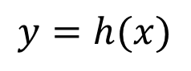
Illustrating Classification Task
E
x
y
$$y=h(x)$$

Slide 6
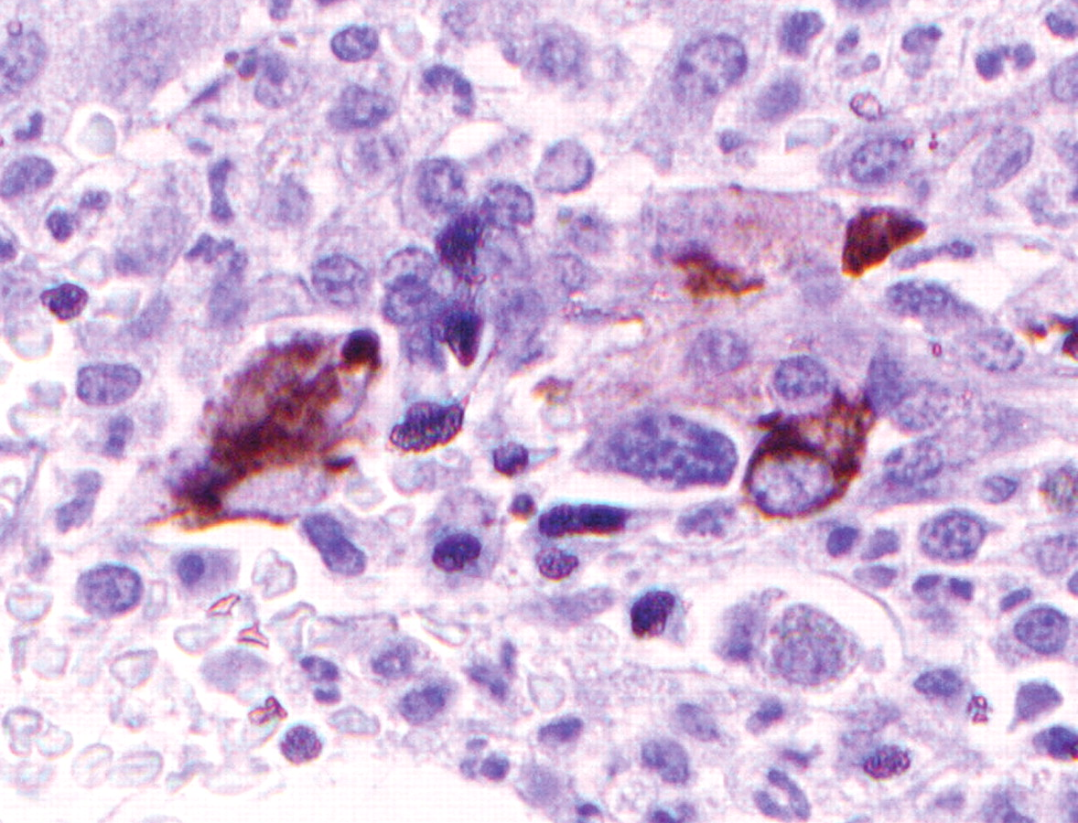

Examples of Classification Task
Predicting tumor cells as benign or malignant.
Classifying credit card transactions as legitimate or fraudulent.
Categorizing news stories as finance, weather, entertainment, sports, etc.

Slide 7
Topics
Introduction
Decision Trees
Overview
Tree Induction
Overfitting and other Practical Issues
Model Selection and Evaluation
Metrics for Performance Evaluation
Methods to Obtain Reliable Estimates
Model Comparison (Relative Performance)
Feature Selection

Slide 8
Example of a Decision Tree
categorical
categorical
continuous
class
Splitting Attributes
Refund
Yes
No
NO
MarSt
Single, Divorced
Married
TaxInc
NO
< 80K
> 80K
NO
YES
Training Data
Model: Decision Tree

Slide 9
Another Example of Decision Tree
categorical
categorical
continuous
class
MarSt
Single, Divorced
Married
NO
Refund
Yes
No
NO
TaxInc
< 80K
> 80K
NO
YES
There could be more than one tree that fits the same data!

Slide 10
Decision Tree: Deduction
Decision Tree

Slide 11
Apply Model to Test Data
Test Data
Start from the root of tree.
Refund
Yes
No
NO
MarSt
Single, Divorced
Married
TaxInc
NO
< 80K
> 80K
NO
YES

Slide 12
Apply Model to Test Data
Test Data
Refund
Yes
No
NO
MarSt
Single, Divorced
Married
TaxInc
NO
< 80K
> 80K
NO
YES

Slide 13
Apply Model to Test Data
Test Data
Refund
Yes
No
NO
MarSt
Single, Divorced
Married
TaxInc
NO
< 80K
> 80K
NO
YES

Slide 14
Apply Model to Test Data
Test Data
Refund
Yes
No
NO
MarSt
Single, Divorced
Married
TaxInc
NO
< 80K
> 80K
NO
YES

Slide 15
Apply Model to Test Data
Test Data
Refund
Yes
No
NO
MarSt
Single, Divorced
Married
TaxInc
NO
< 80K
> 80K
NO
YES

Slide 16
Apply Model to Test Data
Test Data
Refund
Yes
No
NO
MarSt
Single, Divorced
Married
Assign Cheat to “No”
TaxInc
NO
< 80K
> 80K
NO
YES

Slide 17
Topics
Introduction
Decision Trees
Overview
Tree Induction
Overfitting and other Practical Issues
Model Selection and Evaluation
Metrics for Performance Evaluation
Methods to Obtain Reliable Estimates
Model Comparison (Relative Performance)
Feature Selection

Slide 18
Decision Tree: Induction
Decision Tree

Slide 19
Decision Tree Induction
Many Algorithms:
Hunt’s Algorithm (one of the earliest)
CART (Classification And Regression Tree)
ID3, C4.5, C5.0 (by Ross Quinlan, introduced information gain)
CHAID (CHi-squared Automatic Interaction Detection)
MARS (Improvement for numerical features)
SLIQ, SPRINT
Conditional Inference Trees (recursive partitioning using statistical tests)

Slide 20
The Effect of a Split
Refund
Yes
No
Don’t
Cheat
mixed
No: 3 Yes: 0
No: 4 Yes: 3
Every split partitions the data set into two subsets.

Slide 21
Hunt’s Algorithm
"Use attributes to split the data recursively, till each split contains only a single class."
Refund
mixed
Yes
No
Don’t
Cheat
mixed
Refund
Refund
Yes
No
Yes
No
Don’t
Cheat
Marital
Status
Don’t
Cheat
Marital
Status
Single,
Divorced
Married
Single,
Divorced
Married
Taxable
Income
Don’t
Cheat
mixed
Don’t
Cheat
< 80K
>= 80K
Don’t
Cheat
Cheat

Slide 22
Example 2: Creating a Decision Tree
x2
x
x
x
o
x
x
o
x
x
x
o
o
o
o
o
o
o
0
x1

Slide 23
Example 2: Creating a Decision Tree
x2
X2 < 2.5
x
x
Yes
No
x
o
x
Blue circle
Mixed
x
o
x
x
x
2.5
o
o
o
o
o
o
o
0
x1
Decision trees can only cut parallel to an axis!

Slide 24
Example 2: Creating a Decision Tree
x2
X2 < 2.5
x
x
Yes
No
x
o
x
Blue circle
Mixed
x
o
x
x
x
2.5
o
o
o
o
o
o
o
pure
0
x1

Slide 25
Example 2: Creating a Decision Tree
x2
X2 < 2.5
x
x
x
Yes
No
x
o
x
Blue circle
X1 < 2
x
o
x
x
x
2.5
Yes
No
o
o
o
o
o
o
o
Blue circle
Red X
o
o
0
2
x1
2

Slide 26
Tree Induction
Greedy strategy
Split the records based on an attribute test that optimizes a certain criterion.
Issues
How to determine the best split variable? Order?
Refund
Yes
No
Don’t
Cheat
Marital
Status
Single,
Divorced
Married
Determine how to split the records using different attribute types.
Taxable
Income
Don’t
Cheat
< 80K
>= 80K
Determine when to stop splitting.
Don’t
Cheat
Cheat

Slide 27
Tree Induction
Greedy strategy
Split the records based on an attribute test that optimizes a certain criterion.
Issues
Determine how to split the records using different attribute types.
How to determine the best split variable?
Determine when to stop splitting.

Slide 28
How to Specify Test Condition?
Depends on attribute types
Nominal
Ordinal
Continuous (interval/ratio)

Slide 29
Splitting Based on Nominal Attributes
Divide the unordered values into two subsets.
We need to find optimal partitioning.
CarType
CarType
{Sports, Luxury}
OR
{Family, Luxury}
{Family}
{Sports}
CarType
{Family, Sports}
{Luxury}
Best decision depends on what we want to predict!

Slide 30
Splitting Based on Ordinal Attributes
Divide the ordered values into two subsets.
What about this split?
Size
Size
{Small, Medium}
OR
{Medium, Large}
{Large}
{Small}
Size
{Small, Large}
{Medium}

Slide 31
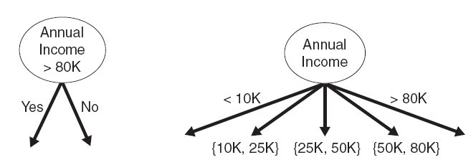
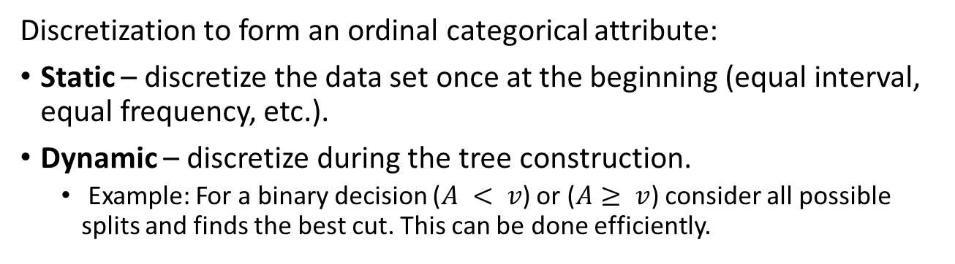
Splitting Based on Continuous Attributes
Binary split Multi-way split
Discretization to form an ordinal categorical attribute:
Static – discretize the data set once at the beginning (equal interval, equal frequency, etc.).
Dynamic – discretize during the tree construction.
Example: For a binary decision ($A < v$) or ($A≥ v$) consider all possible splits and finds the best cut. This can be done efficiently.

Slide 32
Tree Induction
Greedy strategy
Split the records based on an attribute test that optimizes a certain criterion.
Issues
Determine how to split the records using different attribute types.
How to determine the best split variable?
Determine when to stop splitting

Slide 33
How to determine the Best Split
C0: 10 C1: 10
Before Splitting: 10 records of class 0, 10 records of class 1
Which splitting variable is the best?

Slide 34
Determine the Quality of a Node: Node Impurity
Nodes represent a subset of data that satisfy the splitting condition.
We want to create nodes with homogeneous class distributions.
Need a measure of node impurity:
This is preferred
Non-homogeneous, High degree of impurity
Homogeneous, Low degree of impurity
General rule for measures of impurity:
Smaller is better.
0 represents the complete purity.

Slide 35
Find the Best Split: General Framework
Assume we have a measure M that tells us how "pure" a node is.
Before Splitting:
M0
Attribute A
Attribute B
Yes
No
Yes
No
Node N1
Node N2
Node N3
Node N4
M1
M2
Aggregate the purity measure of the child nodes into a single number.
M3
M4
MA
MB
We look at the improvement called the gain: Gain = M0 – MA vs. M0 – MB → Choose best split

Slide 36
Measures of Node Impurity
Gini Index
Entropy
Classification error

Slide 37
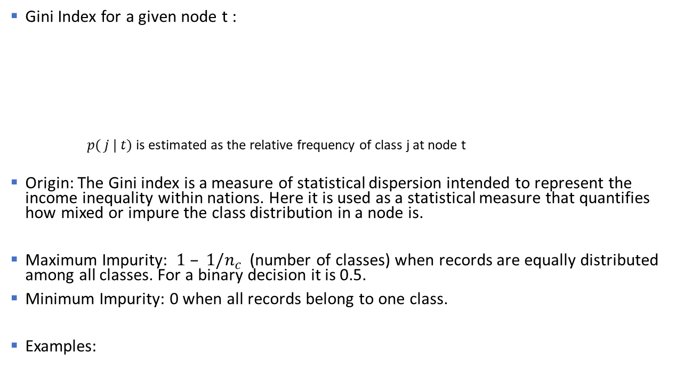
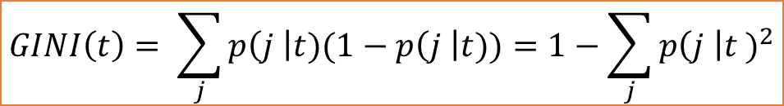
Measure of Impurity: Gini Index of a Node
Gini Index for a given node t :
$p( j | t)$is estimated as the relative frequency of class j at node t
Origin: The Gini index is a measure of statistical dispersion intended to represent the income inequality within nations. Here it is used as a statistical measure that quantifies how mixed or impure the class distribution in a node is.
Maximum Impurity: $1 – 1/n_{c}$(number of classes) when records are equally distributed among all classes. For a binary decision it is 0.5.
Minimum Impurity: 0 when all records belong to one class.
Examples:
$$GINI\left(t\right)= \sum_{j}{p\left(j \right|t)(1−p\left(j \right|t))}=1−\sum_{j}{{p\left(j \right|t )}^{2}}$$

Slide 38
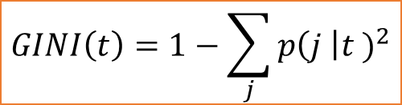
Examples: Gini Index of a Node
$$GINI\left(t\right)=1−\sum_{j}{{p\left(j \right|t )}^{2}}$$
P(C1) = 0/6 = 0 P(C2) = 6/6 = 1
Gini = 1 – P(C1)² – P(C2)² = 1 – 0 – 1 = 0
P(C1) = 1/6 P(C2) = 5/6
Gini = 1 – (1/6)² – (5/6)² = 0.278
P(C1) = 2/6 P(C2) = 4/6
Gini = 1 – (2/6)² – (4/6)² = 0.444
Maximal impurity here is ½ = .5

Slide 39
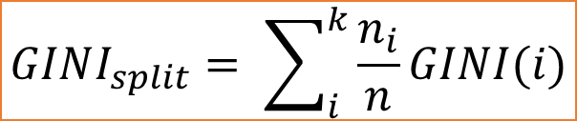
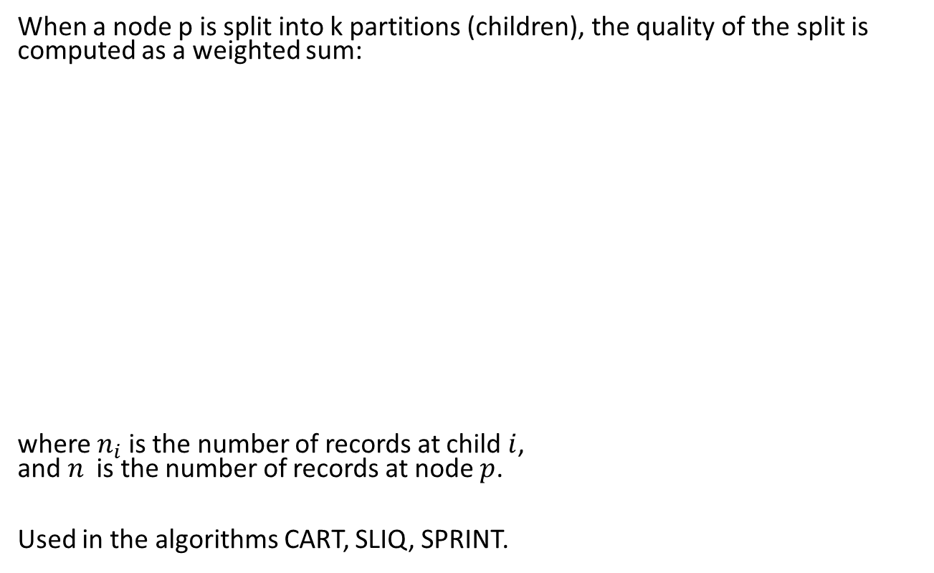
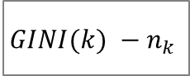
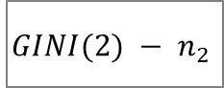
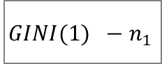
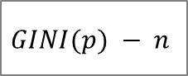
Splitting Based on the Gini Index
When a node p is split into k partitions (children), the quality of the split is computed as a weighted sum:
where $n_{i}$ is the number of records at child $i$, and $n$ is the number of records at node $p$.
Used in the algorithms CART, SLIQ, SPRINT.
$$GINI(p) − n$$
$$GINI(1) −n_{1}$$
$$GINI(2) − n_{2}$$
...
$$GINI(k) −n_{k}$$
$$GINI_{split}= \sum_{i}^{k}{\frac{n_{i}}{n}GINI(i)}$$

Slide 40
Example: Splitting based on the Gini Index
Effect of weighing partitions: Larger and purer partitions are preferred.
B?
Yes
No
Node N1
Node N2
Gini(N1) = 1 – (5/8)² – (3/8)² = 0.469
Gini(N2) = 1 – (1/4)² – (3/4)² = 0.375
Gini of the split = 8/12 * 0.469 + 4/12 * 0.375 = 0.438
Gain = 0.5 – 0.438 = 0.062
GINI improves!

Slide 41
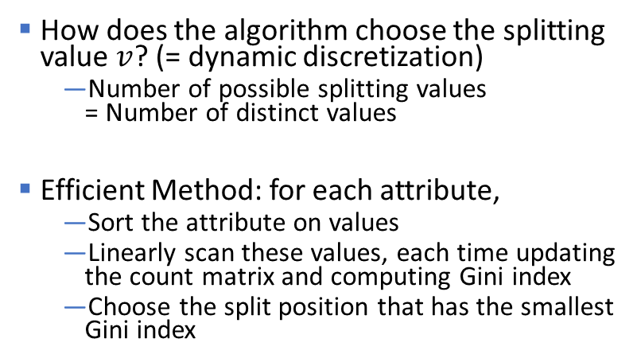
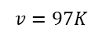
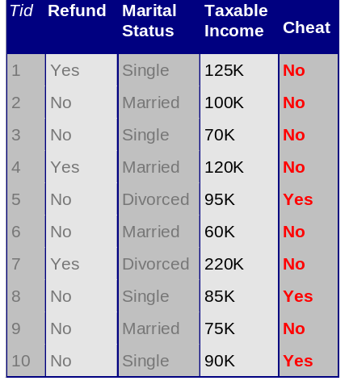
Continuous Attributes: Computing Gini Index
How does the algorithm choose the splitting value $v$? (= dynamic discretization)
Number of possible splitting values = Number of distinct values
Efficient Method: for each attribute,
Sort the attribute on values
Linearly scan these values, each time updating the count matrix and computing Gini index
Choose the split position that has the smallest Gini index
Taxable income > 97K
$$v=97K$$
Yes
No
Sorted Values
Split Positions

Slide 42
Measures of Node Impurity
Gini Index
Entropy
Classification error

Slide 43
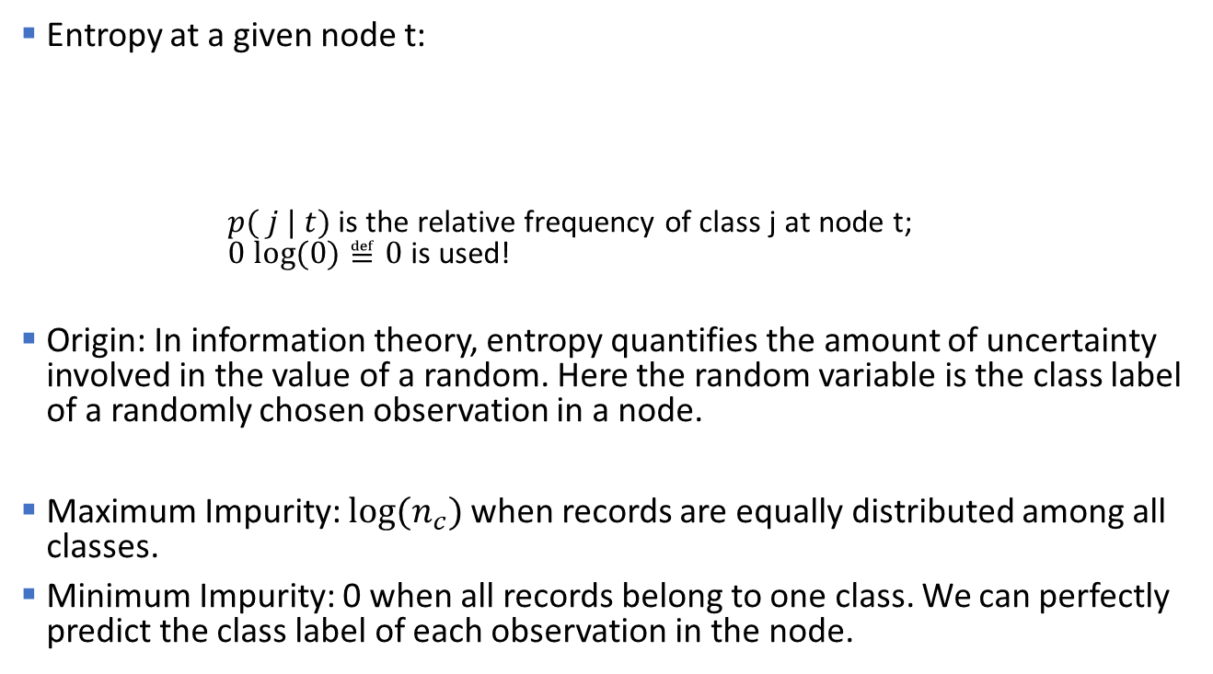
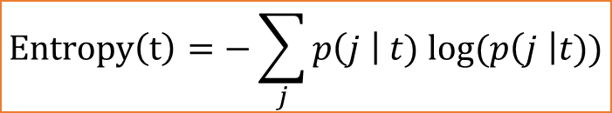
Measure of Impurity: Entropy
Entropy at a given node t:
$p( j | t)$ is the relative frequency of class j at node t; $0 log⁡(0)≝0$is used!
Origin: In information theory, entropy quantifies the amount of uncertainty involved in the value of a random. Here the random variable is the class label of a randomly chosen observation in a node.
Maximum Impurity: $log(n_{c})$ when records are equally distributed among all classes.
Minimum Impurity: 0 when all records belong to one class. We can perfectly predict the class label of each observation in the node.
$$Entropy\left(t\right)=−\sum_{j}{p\left(j \right| t) log⁡(p\left(j \right|t))}$$

Slide 44

Examples: Entropy
$$Entropy\left(t\right)=−\sum_{j}{p\left(j \right| t) log⁡(p\left(j \right|t))}$$
P(C1) = 0/6 = 0 P(C2) = 6/6 = 1
Entropy = – 0 log 0 – 1 log 1 = – 0 – 0 = 0
P(C1) = 1/6 P(C2) = 5/6
Entropy = – (1/6) log₂ (1/6) – (5/6) log₂ (1/6) = 0.65
P(C1) = 3/6 P(C2) = 3/6
Entropy = – (3/6) log₂ (3/6) – (3/6) log₂ (3/6) = 1

Slide 45
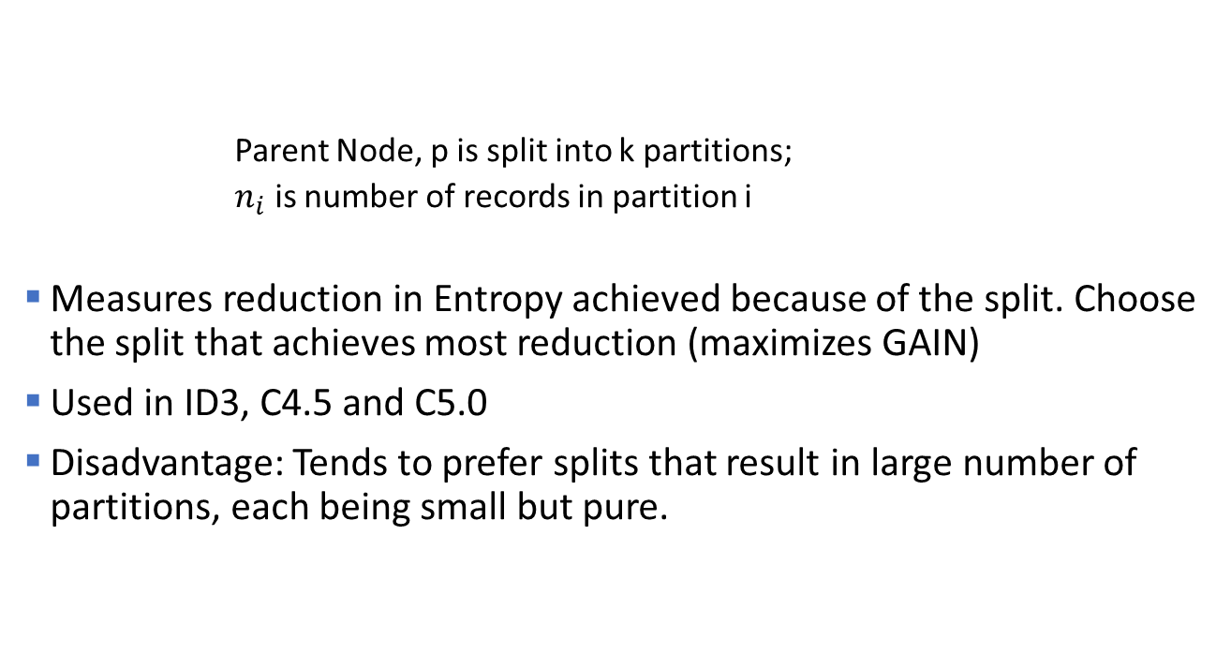
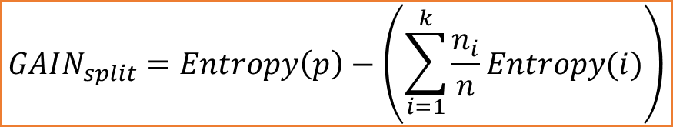
Splitting based on Information Gain
$$GAIN_{split}=Entropy\left(p\right)−\left(\sum_{i=1}^{k}{\frac{n_{i}}{n}Entropy(i)}\right)$$
Parent Node, p is split into k partitions;
$n_{i}$ is number of records in partition i
Measures reduction in Entropy achieved because of the split. Choose the split that achieves most reduction (maximizes GAIN)
Used in ID3, C4.5 and C5.0
Disadvantage: Tends to prefer splits that result in large number of partitions, each being small but pure.

Slide 46
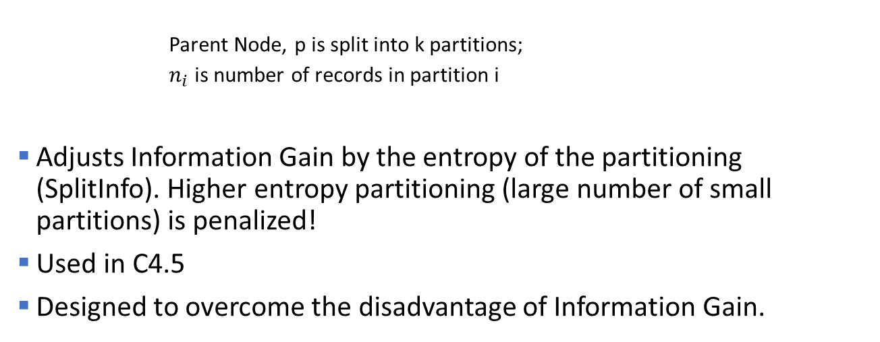
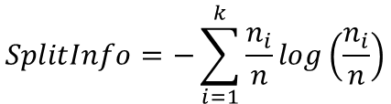
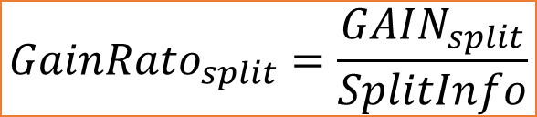
Splitting based on the Gain Ratio
$$GainRato_{split}=\frac{GAIN_{split}}{SplitInfo}$$
$$SplitInfo=−\sum_{i=1}^{k}{\frac{n_{i}}{n}log\left(\frac{n_{i}}{n}\right)}$$
Parent Node, p is split into k partitions;
$n_{i}$ is number of records in partition i
Adjusts Information Gain by the entropy of the partitioning (SplitInfo). Higher entropy partitioning (large number of small partitions) is penalized!
Used in C4.5
Designed to overcome the disadvantage of Information Gain.

Slide 47
Measures of Node Impurity
Gini Index
Entropy
Classification error

Slide 48
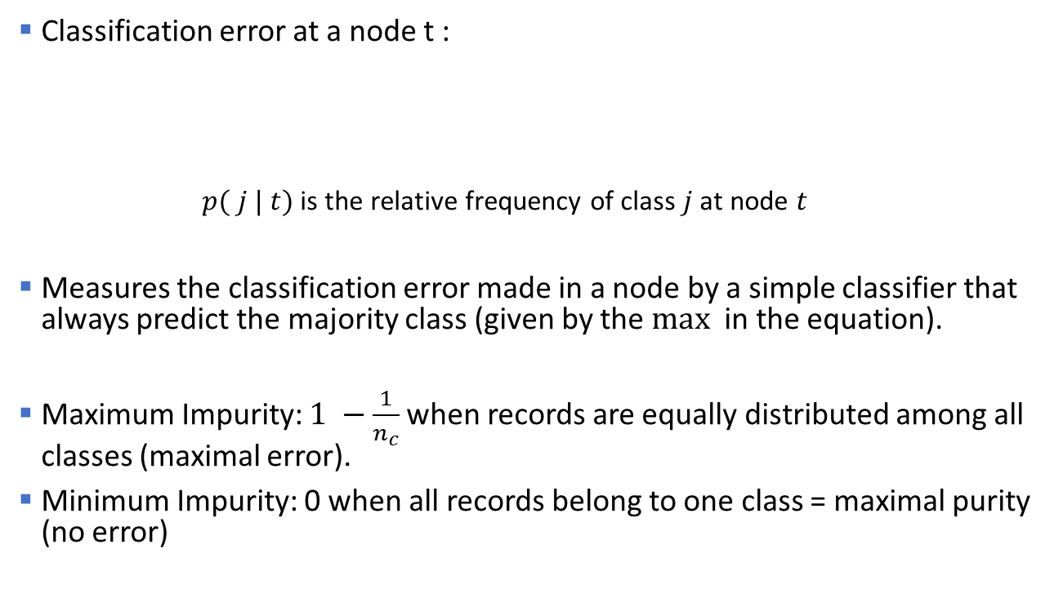
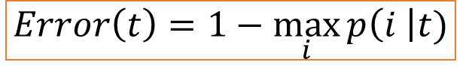
Splitting Criteria based on Classification Error
Classification error at a node t :
$p( j | t)$ is the relative frequency of class $j$ at node $t$
Measures the classification error made in a node by a simple classifier that always predict the majority class (given by the $max⁡$ in the equation).
Maximum Impurity: $1 −\frac{1}{n_{c}}$when records are equally distributed among all classes (maximal error).
Minimum Impurity: 0 when all records belong to one class = maximal purity (no error)
$$Error\left(t\right)=1−\max_{i}{p\left(i \right|t)}$$

Slide 49
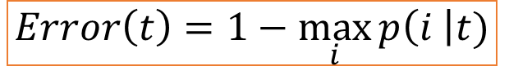
Examples: Classification Error
$$Error\left(t\right)=1−\max_{i}{p\left(i \right|t)}$$
P(C1) = 0/6 = 0 P(C2) = 6/6 = 1
Error = 1 – max (0, 1) = 1 – 1 = 0
P(C1) = 1/6 P(C2) = 5/6
Error = 1 – max (1/6, 5/6) = 1 – 5/6 = 1/6
P(C1) = 3/6 P(C2) = 3/6
Error = 1 – max (3/6, 3/6) = 1 – 3/6 = .5

Slide 50
Splitting based on the Classification Error
Use weighted averages or gain as for the other indices to make the splitting decision.

Slide 51
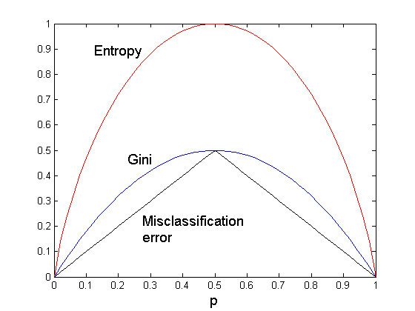
Comparison among Splitting Criteria
For a 2-class problem: Probability of the majority class p is always > .5
Probability of majority class
Note: The order is the same no matter what splitting criterion is used, however, the gain (differences) are not since they depend on the slope.

Slide 52
Classification Error vs Gini Index
A?
Yes
No
Node N1
Node N2
Gini(N1) = 1 – (3/3)² – (0/3)² = 0 Gini(N2) = 1 – (4/7)² – (3/7)² = 0.489
Gini(Split) = 3/10 * 0 + 7/10 * 0.489 = 0.342
Error(N1) = 1-3/3=0 Error(N2)=1-4/7=3/7
Error(Split)= 3/10*0 + 7/10*3/7 = 0.3
Gini improves! Error does not!!!

Slide 53
Tree Induction
Greedy strategy
Split the records based on an attribute test that optimizes a certain criterion.
Issues
Determine how to split the record using different attribute types.
How to determine the best split?
Determine when to stop splitting

Slide 54
Stopping Criteria for Tree Induction
Stop expanding a node when all the records belong to the same class (used Hunt's algorithm).
Stop expanding a node when all the records in the node have the same attribute values. Splitting becomes impossible.
Early termination criterion. Stop when more splits will lead to overfitting the training data. We will discuss this later with tree pruning.
Standard method

Slide 55
Advantages of Decision Trees
Inexpensive to construct
Extremely fast at classifying unknown records
Easy to interpret for small-sized trees
Accuracy is comparable to other classification techniques for many simple data sets

Slide 56
Example: C4.5
Simple depth-first construction.
Uses Information Gain (improvement of the entropy measure).
Handling both continuous and discrete attributes (continuous attributes are split at threshold).
Needs entire data to fit in memory (unsuitable for large datasets).
Final trees are pruned to remove branches that hurt performance.
Code available at
http://www.cse.unsw.edu.au/~quinlan/c4.5r8.tar.gz
Open-Source implementation as J48 in Weka/rWeka

Slide 57
Topics
Introduction
Decision Trees
Overview
Tree Induction
Overfitting and other Practical Issues
Model Selection and Evaluation
Metrics for Performance Evaluation
Methods to Obtain Reliable Estimates
Model Comparison (Relative Performance)
Feature Selection

Slide 58
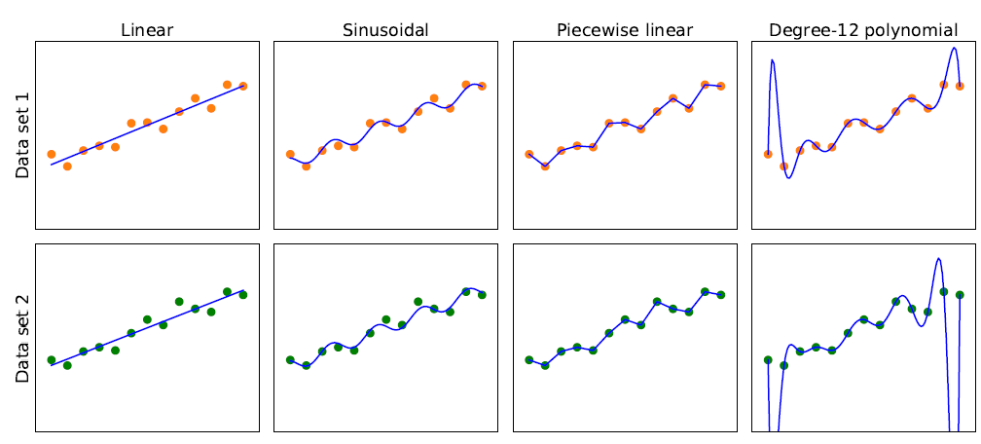
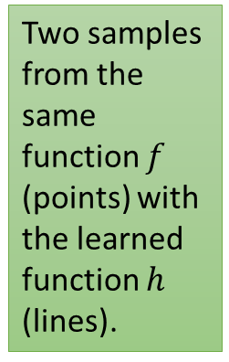
Model Selection: Bias vs. Variance
Overfitting to training data
Simplicity (fewer parameters)
Consistency (fit)
Two samples from the same function $f$ (points) with the learned function $h$ (lines).
High Bias: restrictions by the model class Low
Low Variance: difference in the model due to slightly different data. high
Note: This trade-off applies to any model.

Slide 59
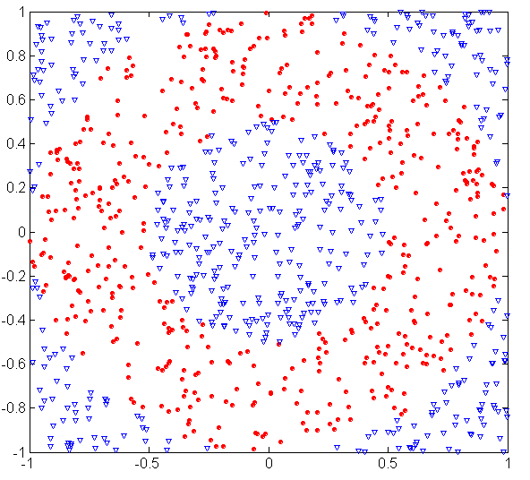
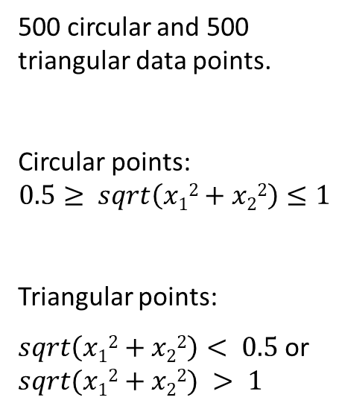
Example: Underfitting and Overfitting
500 circular and 500 triangular data points.
Circular points:
$$0.5≥ sqrt\left(x12+x22\right)≤1$$
Triangular points:
$sqrt\left(x12+x22\right)< 0.5$or $sqrt(x12+x22) > 1$

Slide 60
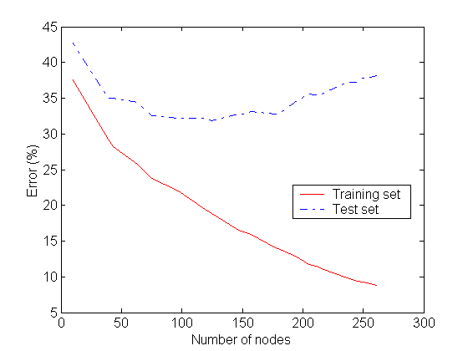
Example: Underfitting and Overfitting
Underfitting
Overfitting
Generalization Error
Resubstitution Error
Underfitting: when model is too simple, both training and test errors are large. Overfitting: when model is too complicated and starts memorizing the training data. Generalization error goes up again.

Slide 61
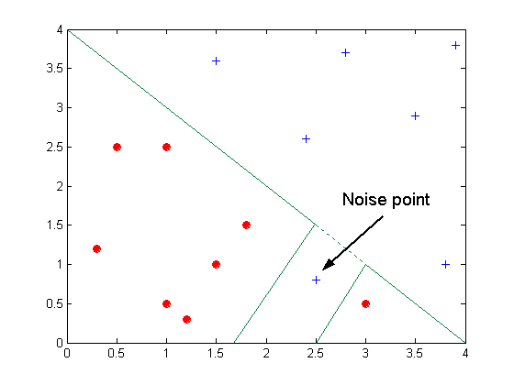
Overfitting due to Noise
Decision boundary is distorted to accommodate a noise point

Slide 62
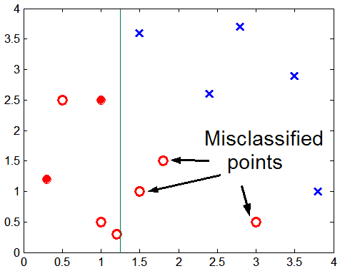
Overfitting due to Insufficient Examples
Training point
Test point
test
Lack of training data points in the lower half of the diagram makes it difficult to predict correctly the class labels of that region

Slide 63
Training Error vs. Generalization Error
Overfitting results in decision trees that are more complex than necessary.
Training error does not provide a good estimate of how well the tree will perform on previously unseen records (e.g., test data).
We need to estimate the Generalization Error.

Slide 64
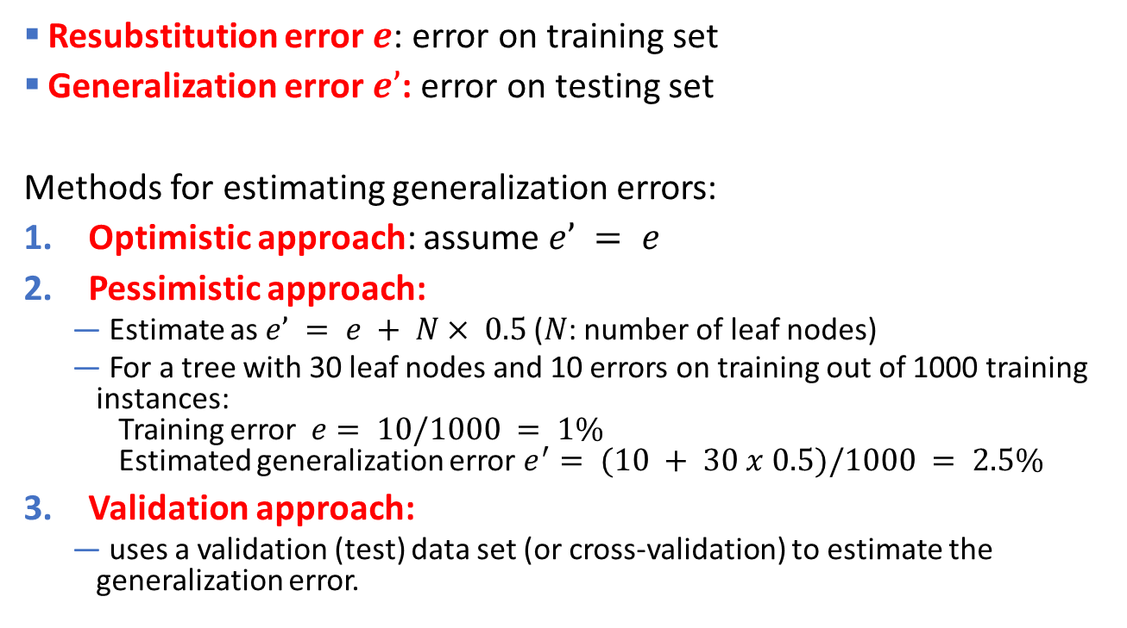
Estimating the Generalization Error
Resubstitution error $e$: error on training set
Generalization error $e’$: error on testing set
Methods for estimating generalization errors:
Optimistic approach: assume $e’ = e$
Pessimistic approach:
Estimate as $e’ = e + N× 0.5$($N$: number of leaf nodes)
For a tree with 30 leaf nodes and 10 errors on training out of 1000 training instances: Training error $e= 10/1000 = 1\%$ Estimated generalization error $e^{′}= (10 + 30 x 0.5)/1000 = 2.5\%$
Validation approach:
uses a validation (test) data set (or cross-validation) to estimate the generalization error.
Penalty for model complexity!
0.5 per leave node is often used for binary splits.

Slide 65

Occam’s Razor - The Principle of Parsimony
"Simpler is better"
Given two models of similar generalization errors, one should prefer the simpler model over the more complex model.
Reason: Complex models have a greater chance of overfitting. I.e., it fitted accidentally errors in the training data.
Therefore, one should include model complexity when evaluating a model.

Slide 66
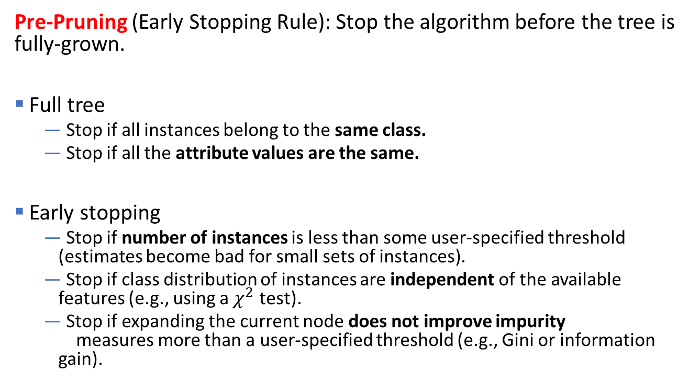
How to Address Overfitting in Decision Trees
Pre-Pruning (Early Stopping Rule): Stop the algorithm before the tree is fully-grown.
Full tree
Stop if all instances belong to the same class.
Stop if all the attribute values are the same.
Early stopping
Stop if number of instances is less than some user-specified threshold (estimates become bad for small sets of instances).
Stop if class distribution of instances are independent of the available features (e.g., using a $χ^{2}$ test).
Stop if expanding the current node does not improve impurity measures more than a user-specified threshold (e.g., Gini or information gain).

Slide 67
How to Address Overfitting in Decision Trees
Post-pruning
Grow complete decision tree.
Try to prune sub-trees of the decision tree in a bottom-up fashion.
If generalization error improves after pruning a sub-tree, replace the sub-tree by a leaf node with the majority class of the training instances as the predicted label.
You can use MDL instead of error for post-pruning.

Slide 68
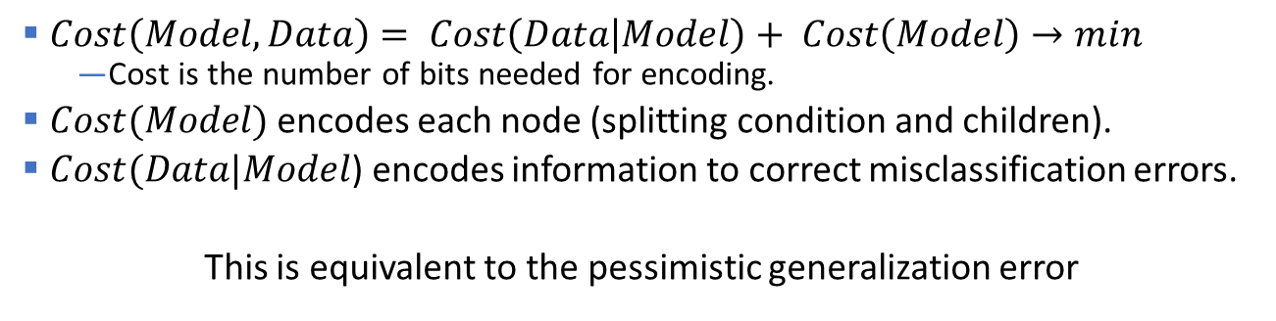
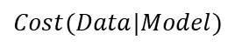
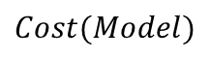
Refresher: Minimum Description Length (MDL)
$$Cost(Model)$$
Penalty for model complexity!
mistakes
$$Cost(Data|Model)$$
$Cost\left(Model,Data\right)= Cost\left(Data | Model\right)+ Cost\left(Model\right)→min$
Cost is the number of bits needed for encoding.
$Cost(Model)$encodes each node (splitting condition and children).
$Cost(Data|Model$) encodes information to correct misclassification errors.
This is equivalent to the pessimistic generalization error

Slide 69
Example: Post-Pruning
Before split: Training Error = 10/30 Pessimistic error = (10 + 1 x 0.5)/30 = 10.5/30
After split: Training Error = 9/30 Pessimistic error = (9 + 4 x 0.5)/30 = 11/30
Class = Yes | 20
Class = No | 10
Error = 10/30
Training error decreases but pessimistic error estimate increases! PRUNE!
Class = Yes | 8
Class = No | 4
Class = Yes | 3
Class = No | 4
Class = Yes | 4
Class = No | 1
Class = Yes | 5
Class = No | 1
Error = 9

Slide 70
Other issues: Data Fragmentation and Search Strategy
Data Fragmentation
Number of instances gets smaller as you traverse down the tree and can become too small to make a statistically significant decision (splitting or determining the class in a leaf node)
→ Many algorithms stop when a node has not enough instances.
Search Strategy
Finding an optimal decision tree is NP-hard
→ Most algorithm use a greedy, top-down, recursive partitioning strategy to induce a reasonable solution.

Slide 71
Other issues: Tree Replication
Same subtree appears in multiple branches
Makes the model more complicated and harder to interpret

Slide 72
Expressiveness of Decision Trees
Decision tree can learn discrete-valued functions to separate classes.
This function represents the decision boundary.
Issues
Not expressive enough for modeling continuous variables directly. Discretization is performed for the splits.
Do not generalize well to certain types of Boolean functions like the parity function (Class = 1 if there is an even number of Boolean attributes with truth value = True and 0 otherwise). These functions lead to excessive tree replication.

Slide 73
Decision Boundary
The border line between two neighboring regions of different classes is known as the decision boundary.
The decision boundary is parallel to the axes because each test condition represents a threshold on a single attribute.

Slide 74
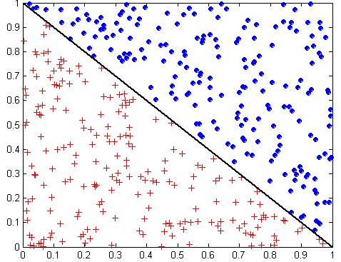
Oblique Decision Trees
x + y < 1
Class = +
Class =
The test condition may involve multiple attributes.
More expressive representation.
Finding the optimal test condition is computationally expensive! -> Not used in practice.

Slide 75

Topics
Introduction
Decision Trees
Overview
Tree Induction
Overfitting and other Practical Issues
Model Selection and Evaluation
Metrics for Performance Evaluation
Methods to Obtain Reliable Estimates
Model Comparison (Relative Performance)
Feature Selection

Slide 76
Metrics for Performance Evaluation: Confusion Matrix
Focuses on the predictive capability of a model (not speed, scalability, etc.)
For simplicity, we will present a binary classification problem here, but most measures generalize to multi-class problems.
Confusion Matrix
 | PREDICTED CLASS
ACTUAL CLASS |  | Class=Yes | Class=No
 | Class=Yes | a (TP) | b (FN)
 | Class=No | c (FP) | d (TN)
a: TP (true positive)
b: FN (false negative)
c: FP (false positive)
d: TN (true negative)

Slide 77
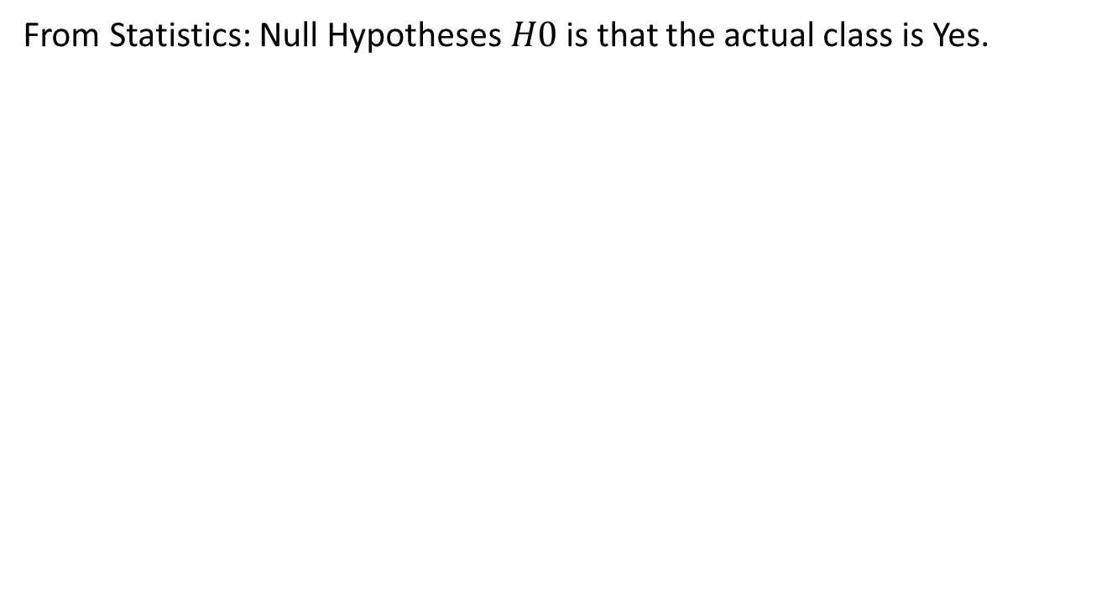
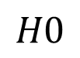
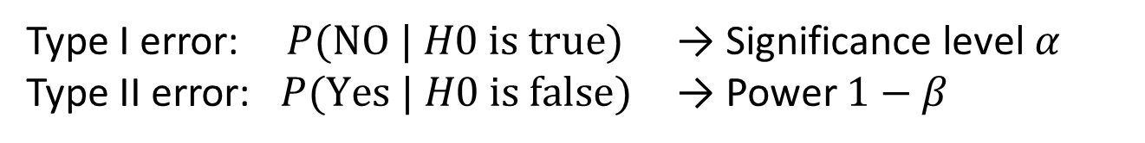
Metrics for Performance Evaluation: Statistical Test
From Statistics: Null Hypotheses $H0$ is that the actual class is Yes.
 | PREDICTED CLASS
ACTUAL CLASS |  | Class=Yes | Class=No
 | Class=Yes |  | Type I error (FN)
 | Class=No | Type II error (FP)
$$H0$$
Type I error: $P(\text{NO} | H0 \text{is} \text{true})$ → Significance level $α$
Type II error: $P(\text{Yes} | H0 \text{is} \text{false})$ → Power $1−β$

Slide 78
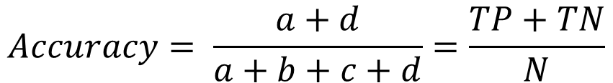
Metrics for Performance Evaluation: Accuracy
Most widely-used metric: How many do we predict correct (in percent)?
 | PREDICTED CLASS
ACTUAL CLASS |  | Class=Yes | Class=No
 | Class=Yes | a (TP) | b (FN)
 | Class=No | c (FP) | d (TN)
$$Accuracy= \frac{a+d}{a+b+c+d}=\frac{TP+TN}{N}$$

Slide 79
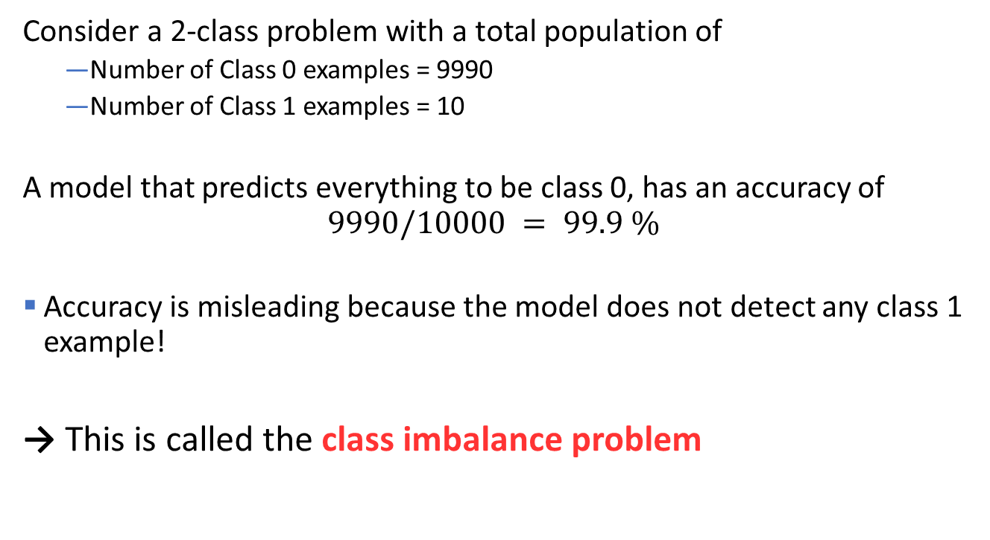
Limitation of Accuracy
Consider a 2-class problem with a total population of
Number of Class 0 examples = 9990
Number of Class 1 examples = 10
A model that predicts everything to be class 0, has an accuracy of $$9990/10000 = 99.9 \%$$
Accuracy is misleading because the model does not detect any class 1 example!
→ This is called the class imbalance problem

Slide 80
Cost Matrix
Different types of error can have different cost!
 | PREDICTED CLASS
ACTUAL CLASS | C(i|j) | Class=Yes | Class=No
 | Class=Yes | C(Yes|Yes) | C(No|Yes)
 | Class=No | C(Yes|No) | C(No|No)
$C\left(i \right| j)$: Cost of misclassifying class$j$example as class $i$

Slide 81
Computing Cost of Classification
Cost Matrix | PREDICTED CLASS
ACTUAL CLASS | C(i|j) | + | -
 | + | -1 | 100
 | - | 1 | 0
Missing a ‘+’ case is really expensive!
Model M₁ | PREDICTED CLASS
ACTUAL CLASS |  | + | -
 | + | 150 | 40
 | - | 60 | 250
Model M₂ | PREDICTED CLASS
ACTUAL CLASS |  | + | -
 | + | 250 | 45
 | - | 5 | 200
Accuracy = 80%
Cost = -1*150+100*40+ 1*60+0*250 = 3910
Accuracy = 90%
Cost = 4255

Slide 82

Cost vs Accuracy
Count | PREDICTED CLASS
ACTUAL CLASS |  | Class=Yes | Class=No
 | Class=Yes | a | b
 | Class=No | c | d
Accuracy is only proportional to cost if 1. C(Yes|No)=C(No|Yes) = q 2. C(Yes|Yes)=C(No|No) = p
$$N = a + b + c + d$$
Accuracy $= (a + d)/N$
Cost $= p (a + d) + q (b + c)$
$$= p (a + d) + q (N – a – d)$$
$$= q N – (q – p)(a + d)$$
$$= N [q – \left(q−p\right)× \text{Accuracy}]$$
Cost | PREDICTED CLASS
ACTUAL CLASS |  | Class=Yes | Class=No
 | Class=Yes | p | q
 | Class=No | q | p

Slide 83

Cost-Biased Measures
 | PREDICTED CLASS
ACTUAL CLASS |  | Class Yes | Class No
 | Class Yes | a (TP) | b (FN)
 | Class No | c (FP) | d (TN)
$$Precision \left(p\right)=\frac{a}{a+c} \\ Recall \left(r\right)=\frac{a}{a+b} \\ F−measure \left(F\right)=\frac{2rp}{r+p}=\frac{2a}{2a+b+c}$$
Precision is biased towards C(Yes|Yes) & C(Yes|No)
Recall is biased towards C(Yes|Yes) & C(No|Yes)
F-measure is biased towards all except C(No|No)

Slide 84

Kappa Statistic
 | PREDICTED CLASS
ACTUAL CLASS |  | Class Yes | Class No
 | Class Yes | a (TP) | b (FN)
 | Class No | c (FP) | d (TN)
Idea: Compare the accuracy of the classifier with a random classifier. The classifier should be better than random!
$$κ=\frac{\text{total} \text{accuracy} −\text{random} \text{accuracy}}{1 −\text{random} \text{accuracy}} \\ \text{total} \text{accuracy}=\frac{TP+TN}{N} \\ \text{random} \text{accuracy}=\frac{TP+FP×TN+FN+FN+TN×FP+TP}{N^{2}}$$

Slide 85


Receiver Operating Characteristic (ROC)
Developed in 1950s for signal detection theory to analyze noisy signals to characterize the trade-off between positive hits and false alarms.
Works only for binary classification (two-class problems).
ROC curve plots TPR (true positive rate) on the y-axis against FPR (false positive rate) on the x-axis.
Performance of each classifier represented as a point. Changing the threshold of the algorithm, sample distribution or cost matrix changes the location of the point and forms a curve.

Slide 86

ROC Curve
Example with 1-dimensional data set containing 2 classes (positive and negative)
Any points located at x > t is classified as positive
ROC
Prob
t
TPR=0.5
At threshold t: TPR=0.5, FNR=0.5, FPR=0.12, FNR=0.88
FPR=0.12
Move t to get the other points on the ROC curve.

Slide 87
ROC Curve
Ideal Classifier
Random Guessing Line
(TPR,FPR):
(0,0): declare everything to be negative class
(1,1): declare everything to be positive class
(1,0): ideal
Diagonal line:
Random guessing
Below diagonal line: prediction is opposite of the true class
Below the diagonal: predict the opposite class

Slide 88

Using ROC for Model Comparison
No model consistently outperform the other
M1 is better for small FPR
M2 is better for large FPR
Area Under the ROC curve (AUC)
Ideal:
AUC = 1
Random guess:
AUC = 0.5

Slide 89
Topics
Introduction
Decision Trees
Overview
Tree Induction
Overfitting and other Practical Issues
Model Selection and Evaluation
Metrics for Performance Evaluation
Methods to Obtain Reliable Estimates
Model Comparison (Relative Performance)
Feature Selection

Slide 90

Learning Curve
Accuracy and variance between runs depend on the size of the training data.
Learning curve shows how accuracy on unseen examples changes with varying training sample size
Variation for different runs
Training data size (log scale)

Slide 91

Training and Test Data
Separate data into a set to train and a set to test.
Holdout testing/Random splits: Split the data randomly into, e.g., 80% training and 20% testing.
k-fold cross validation: Use training & validation data better
Split the training & validation data randomly into k folds.
For $k$ rounds hold 1 fold back for testing and use the remaining $k−1$ folds for training.
Use the average the error/accuracy as a better estimate.
Some algorithms/tools do that internally.
LOOCV (leave-one-out cross validation): $k = n$used if very little data is available.
Very important: the algorithm can never look at the test set during learning!
Training
Data
Test
Data

Slide 92
Training and Testing with Hyperparameters
Hyperparameters: Many algorithms allow choices for learning. E.g.,
maximal decision tree depth
selected features
Train: Learn models on the training data (without the validation data) using different hyperparameters.
A grid of possible hyperparameter combinations
greedy search
Model Selection: Evaluate the models using the validation data and choose the hyperparameters with the best accuracy. Rebuild the model using all the training data.
Test the final model using the test data.
Training
Data
Validation
Data
Test
Data

Slide 93
How to Split the Dataset into Training and Validation Set
Random splits: Split the data randomly in 60% training, 20% validation, and 20% testing.
k-fold cross validation: Use training & validation data better
split the training & validation data randomly into k folds.
For k rounds hold 1 fold back for testing and use the remaining k-1 folds for training.
Use the average the error/accuracy as a better estimate.
Some algorithms/tools do that internally.
Training
Data
Validation
Data
Test
Data

Slide 94


Confidence Interval for Accuracy
Each prediction can be regarded as a Bernoulli trial: A Bernoulli trial (a biased coin toss) has 2 possible outcomes: heads (correct) or tails (wrong) We use $p$ for the true chance that prediction is correct (= true accuracy).
Predictions for a test set of size $N$ are a collection of $N$ Bernoulli trials. The number of correct predictions $x$ has a Binomial distribution:
$$X \sim Binomial\left(N, p\right)$$ Example: Toss a fair coin 50 times, how many heads would turn up? Expected number of heads $E[X]= Np = 50× 0.5 = 25$
If we observe $x$ correct predictions then the observed accuracy is
$\hat{p}=x/N$ Can we give bounds for the true accuracy of model $p$?

Slide 95





Confidence Interval for Accuracy
$$Area = 1 −α$$
For large test sets ($N > 30$) we can approximate the Binomial distribution by a Normal distribution:
$$X \sim Normal(Np, Np\left(1−p\right))$$
Confidence Interval for $p=X/N$(Wald Method):
$$\hat{p}±z_{α/2}\sqrt{\frac{\hat{p}\left(1−\hat{p}\right)}{N}}$$
$$−z_{α/2}$$
$$z_{α/2}$$

Slide 96




Confidence Interval for Accuracy
Consider a model that produces an accuracy of 80% when evaluated on 100 test instances:
$N = 100, acc = 0.8$
Let $1−α= 0.95$(95% confidence)
From probability table, $z_{α/2} =1.96$
$$1−α/2$$ | $$z_{α/2}$$
0.99 | 2.58
0.98 | 2.33
0.95 | 1.96
0.90 | 1.65
$$\hat{p}±z_{α/2}\sqrt{\frac{\hat{p}\left(1−\hat{p}\right)}{N}}$$
N | 50 | 100 | 500 | 1000 | 5000
p(lower) | 0.689 | 0.722 | 0.765 | 0.775 | 0.789
p(upper) | 0.911 | 0.878 | 0.835 | 0.825 | 0.811
Table or R $qnorm(1−α/2)$
Data mining tools typically calculate this for us.

Slide 97
Topics
Introduction
Decision Trees
Overview
Tree Induction
Overfitting and other Practical Issues
Model Selection and Evaluation
Metrics for Performance Evaluation
Methods to Obtain Reliable Estimates
Model Comparison (Relative Performance)
Feature Selection

Slide 98

Comparing Performance between 2 Models
Given two models, say $M_{1}$ and $M2$, which is better?
For large test sets ($N > 30$) we have approximately:
$$acc_{1} \sim Normal(p_{1},{Np}_{1}\left(1−p_{1}\right))$$
$$acc_{2} \sim Normal(p_{2},{Np}_{2}(1−p_{2}))$$
Perform a paired t-test with:
H0: There is no difference in accuracy between the models.
H1: There is a difference.
Comparing more than two models: You need to correct for multiple comparisons! For example, using Bonferroni correction or False Discovery Rate (FDR).

Slide 99

Topics
Introduction
Decision Trees
Overview
Tree Induction
Overfitting and other Practical Issues
Model Selection and Evaluation
Metrics for Performance Evaluation
Methods to Obtain Reliable Estimates
Model Comparison (Relative Performance)
Feature Selection

Slide 100
Feature Selection
What features should be used in the model?
Univariate feature importance score
Measures how related each feature is to the class variable.
Feature subset selection
Tries to find the best set of features.
E.g., chi-squared statistic, information gain.
Often uses a black box approach where different subsets are evaluated using a greedy search strategy.
E.g.: Stepwise backward selection tries to remove one feature at a time.

Slide 101

Conclusion
Classification is supervised learning with the goal to find a model that generalizes well.
Generalization error can be estimated using test sets/cross-validation and should be used for model selection.
Model evaluation and comparison needs to take model complexity into account.

